Slide 1
Reading and Writing to files

Slide 2
Resources
eBook
Hard Copy book
Visualizing Code tool
Cheat Sheets
*Control click to go to the link.

Slide 3
File Types
Python can write to various file types (csv, texts, pdfs) and databases
You can use pre-built libraries such as csv and os
You can also download external modules such as pandas or openpyxl, pypdf

Slide 4
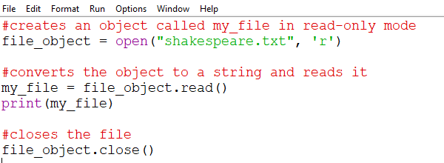
Reading Text files
Text files (.txt) are a very common way to store data
Various file extensions (HTML, CSS, Cookies, Py, CSV, XML, etc) are actually .txt files which can be opened with notepad.
See Python tutorial for additional reading functions

Slide 5
Open arguments
The second argument will be the mode (read, write, append)
If a second argument is not selected, it will be read only by default
Mode (Second Argument) | Access Level | Clear/Overwrite file | Position in file | Create File if Does not exist
r | read only | No | Beginning | No
r+ | Read and write | No | Beginning | Yes
w | Write only | Yes | Beginning | Yes
w+ | Read and write | Yes | Beginning | Yes
a | Write only | No | End | Yes
a+ | Read and write | No | End | Yes

Slide 6
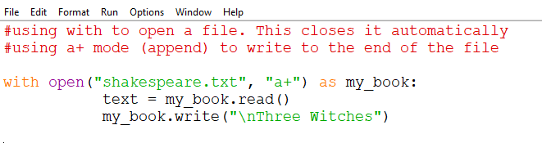
writing to Text files
Caution: Making changes to files using Python can be permanent.
Do not use important files unless you have file backups or version control
See Python Tutorial for additional writing functions

Slide 7
writing to Text files
Caution: Making changes to files using Python can be permanent.
Do not use important files unless you have file backups or version control
See Python Tutorial for additional writing functions

Slide 8
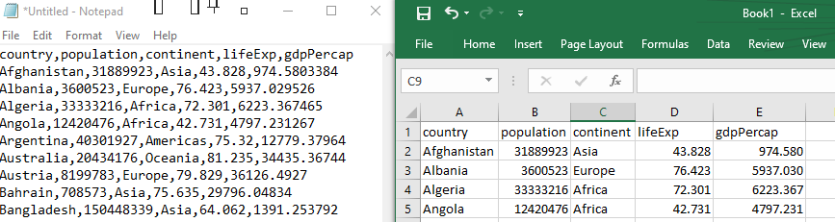
What are CSV files
CSV files stand for comma separated values. They are commonly opened as Excel Spreadsheets but are a text file.
Each value is separated by a comma and displayed in individual cells in Excel
While Excel can convert values to dates, integers, currency, etc., every value in a CSV file is a string

Slide 9
How to open, read and write to CSV files
Import the CSV module
csv.reader(csvfile)
See Python docs for full list of functions

Slide 10

Intro to Data Science with Pandas, Numpy and matplotlib
Import the modules with their respective alias
Numpy is preferred for numerical data and pandas is preferred with tabular data
Numpy creates multi-dimensional areas (similar to nesting lists) and pandas creates 2d tables called DataFrames
Matplotlib is used to visualize data and create graphs, charts, etc

